Slide 1
Final Project-Part3
Accelerate Irregular Sparse Convolution Neural Network with CUDA
NCTU 2017 Fall Computer Architecture
TA： Jyun-Wei Pan
Email：s0550233.ee05g@g2.nctu.edu.tw
Lab： Parallel Computing System - ED520

Slide 2

Outline
Sparse format
Irregular Distribution
Assignment
Grading Policy
Hints
Cuda Dynamic Parallelism
Reference

Slide 3
Outline
Sparse format
Irregular Distribution
Assignment
Grading Policy
Hints
Cuda Dynamic Parallelism
Reference

Slide 4
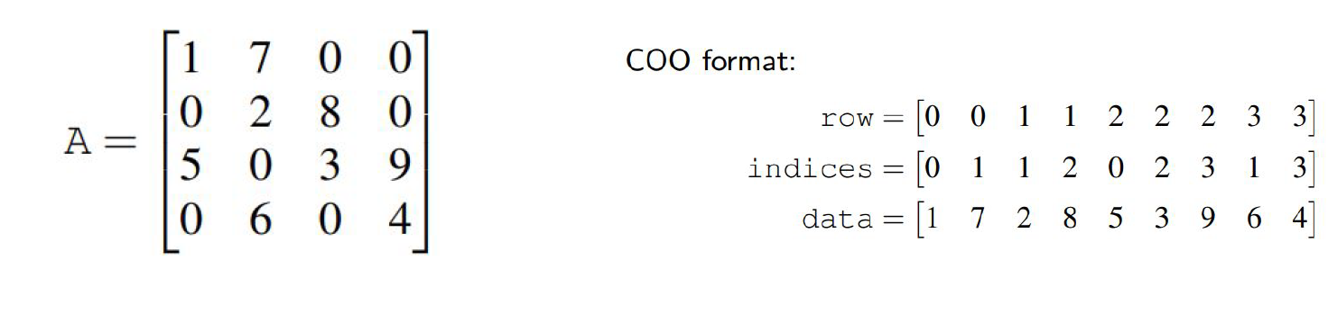
Sparse format
In part3, TA provides the same data set in COO format.
Actually , there are other sparse format Ex: CSR、CSC、ELL、DIA.

Slide 5
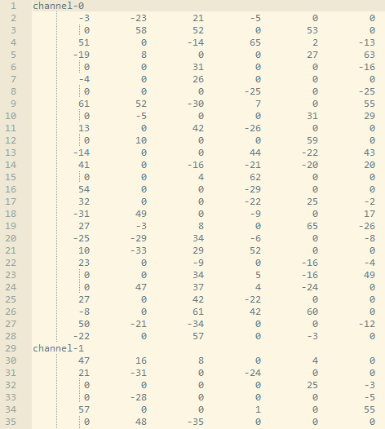
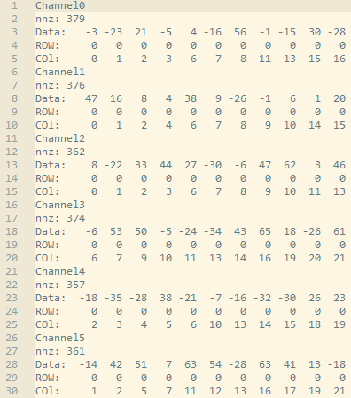
Neuron_COO.txt

Slide 6
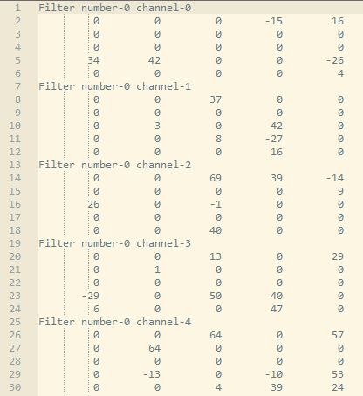
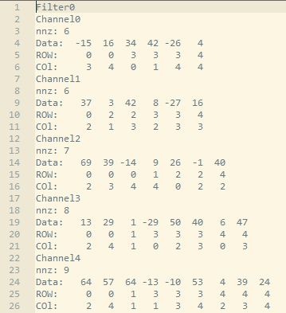
Filter_COO.txt

Slide 7
Outline
Sparse format
Irregular Distribution
Assignment
Grading Policy
Hints
Cuda Dynamic Parallelism
Reference

Slide 8
Irregular Distribution
The number of non-zero data in each lane of neurons ：
28
28

Slide 9
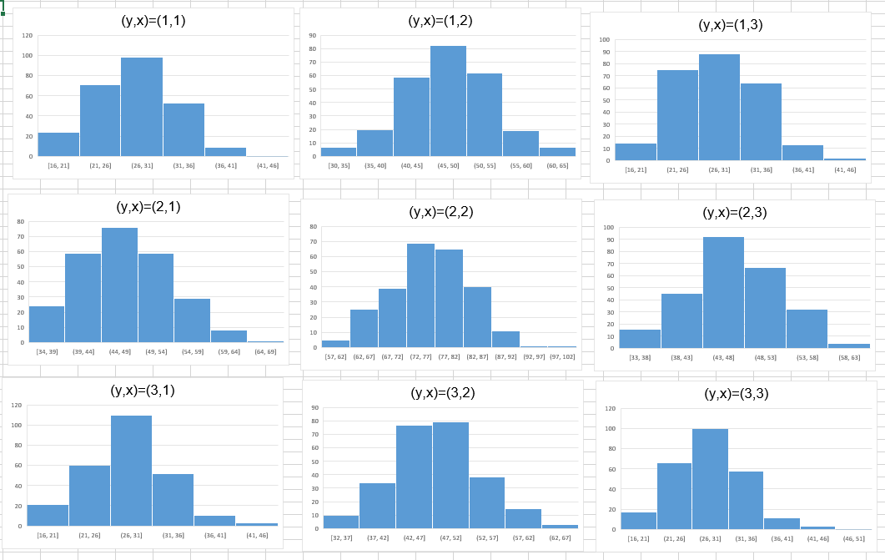
Irregular Distribution
The number of non-zero data in each lane of filters ：
…
…
…
…
Y-axis：The No. of filters
X-axis：The No. of nonzero in a lane

Slide 10
Outline
Sparse format
Irregular Distribution
Assignment
Grading Policy
Hints
Cuda Dynamic Parallelism
Reference

Slide 11
Assignment
Task：
Speedup irregular sparse convolution.
Base Program：
Three sub-directories under the source directory
./device contains a program that can show you device information.
./example contains the Inner Product in cuda dynamic parallelism.
./data contains the input data for the base program.
Two major files for base program
CNNConvLayer.cu and CNNConvLayer.h

Slide 12
Input data files (Please do not modify the input data)
./data/filter.txt storing irregular dense filters’ values (sparsity=78%)
./data/neuron.txt storing irregular dense neuron’ values(sparsity=78%)
./data/filter_COO_irregular.txt storing irregular sparse filters’ values (sparsity=78%)
./data/neuron_COO_ irregular.txt storing irregular sparse neuron’ values(sparsity=78%)
./data/filter_COO_regular.txt storing sparse filters’ values(sparsity=78%)
./data/neuron_COO_ regular.txt storing sparse neuron’ values(sparsity=78%)
TA will test your code with filter_COO_irregular.txt and neuron_COO_ irregular.txt (or you can use other sparse format and please compress the data into zip file)
We will compare the execution time to get the speedup
Speedup = convLayerGPU_TA_execTime / convLayerGPU_Your_execTime
convLayerGPU_XXX_execTime includes : only execution time.

Slide 13
Other Rules
1. It’s a team work, 1 ~ 6 people in one team. In part3, you can change your team.
- Register here before deadline
2. Compress following files into one zip file LeaderID_FP3.zip (ex：066066_FP3.zip)
and upload to E3.
(a) LeaderID_Report_FP3.pdf
(b) CNNConvLayer.cu and CNNConvLayer.h
(c) Makefile and ./data
3. Make sure TA can compile and run your code with “make” and “make run”.
4. One team only need to upload one package to E3.
5. Any CUDA library is forbidden to use in this project !!!
6. DELAY IS NOT ACCEPTABLE !!!

Slide 14
Environment
Get base program source code with below command：
$ git clone https://github.com/s0606757/CA2017FP-Part3.git
We provide you a Linux server with NVIDIA GPU K20：
IP: 140.113.225.114 SSH Port: 22
Account：ca01~58 (Account List)
Remember to enable X11 forwarding when you connect to the server for using the
NVIDIA Visual Profiler.
Your code will be evaluated on this server.
Due day：2018/01/16 (Tue) 23:50

Slide 15
Outline
Sparse format
Irregular Distribution
Assignment
Grading Policy
Hints
Cuda Dynamic Parallelism
Reference

Slide 16
Grading Policy
(A) Completeness (30%)
Your result(convLayerGPU_Your) must be correct (Pass the check) (15%)
Your design(convLayerGPU_Your) is faster than convLayerGPU_TA (15%)
(B) Report (40%)
See Report template
(C) Performance Rank (30%)
We will rank your CUDA kernels’ performance(execution time) on GTX K20C
The fastest one will get 30% and the last one will get 1%

Slide 17
Outline
Sparse format
Irregular Distribution
Cuda Dynamic Parallelism
Assignment
Grading Policy
Hints
Reference

Slide 18
Hint
1. Data reuse can reduce the times of reloading data from global memory to shared
memory.
2. Reduce branches can reduce control divergence that causes some threads to stall.
3. Memory coalescing can efficiently access memory.
4. Cuda dynamic parallel maybe have some helps. In this Part, You can implement "any idea" to speed up irregular sparse convolution. Cuda dynamic parallel is not the only approach.

Slide 19
Outline
Sparse format
Irregular Distribution
Assignment
Grading Policy
Hints
Cuda Dynamic Parallelism
Reference

Slide 20
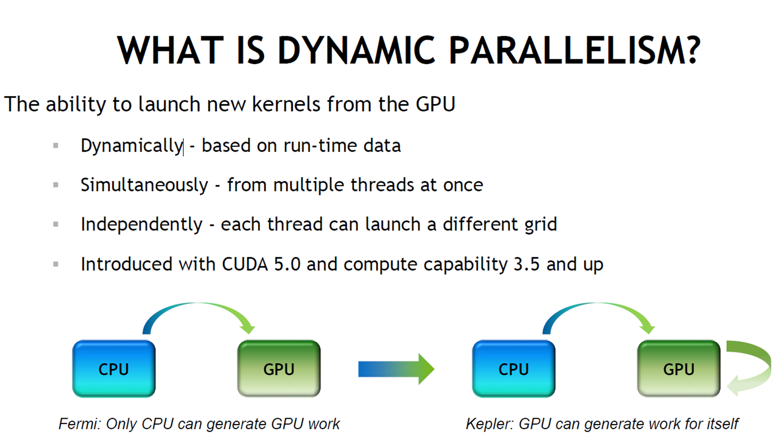
Cuda Dynamic Parallelism

Slide 21
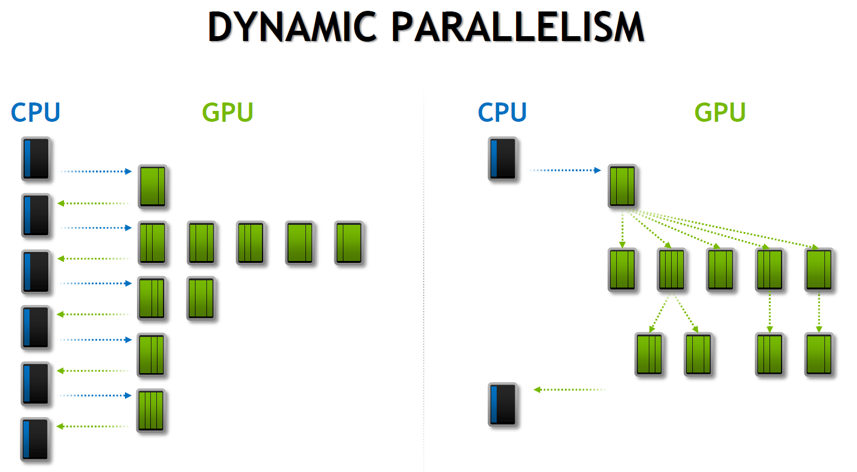

Slide 22
Outline
Sparse format
Irregular Distribution
Assignment
Grading Policy
Hints
Cuda Dynamic Parallelism
Reference

Slide 23
Reference
Sparse Format in Matrix Multiplication
Implement Sparse Matrix Multiplication with Cuda
Sparse Format – Nvidia
Cuda Debugging Command Line
Cuda Dynamic Parallel
Branch Divergence
Memory Coalescing

